Slide 1


Bakery sales Data analysis
Final project for NTI data analysis course
By Roaa Bahaa

Slide 2
What I used in my project
Kaggle : getting data
Python : cleaning the data
Power BI : making dashboard and visualization data

Slide 3
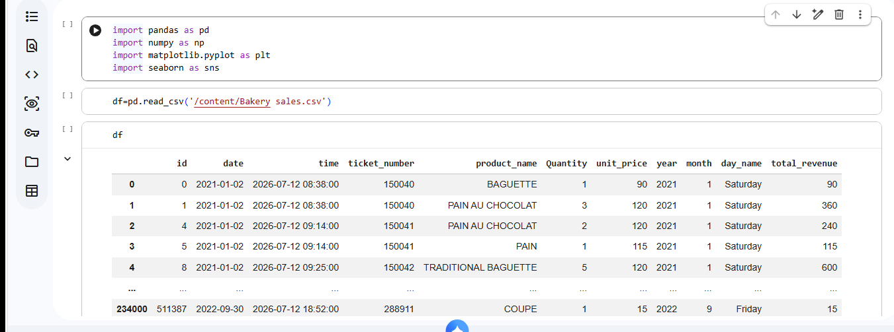
How did I clean the data in python
First upload the data to work with it

Slide 4
Change the data type

Slide 5
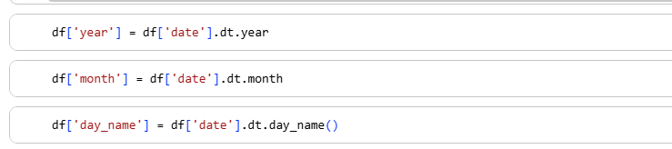
Make some new columns

Slide 6
Remove the € from the price column so I can do calculation

Slide 7
Change column name

Slide 8

And finally saved the data cleaned

Slide 9

Now lets see the dashboard in power BI

